Slide 1
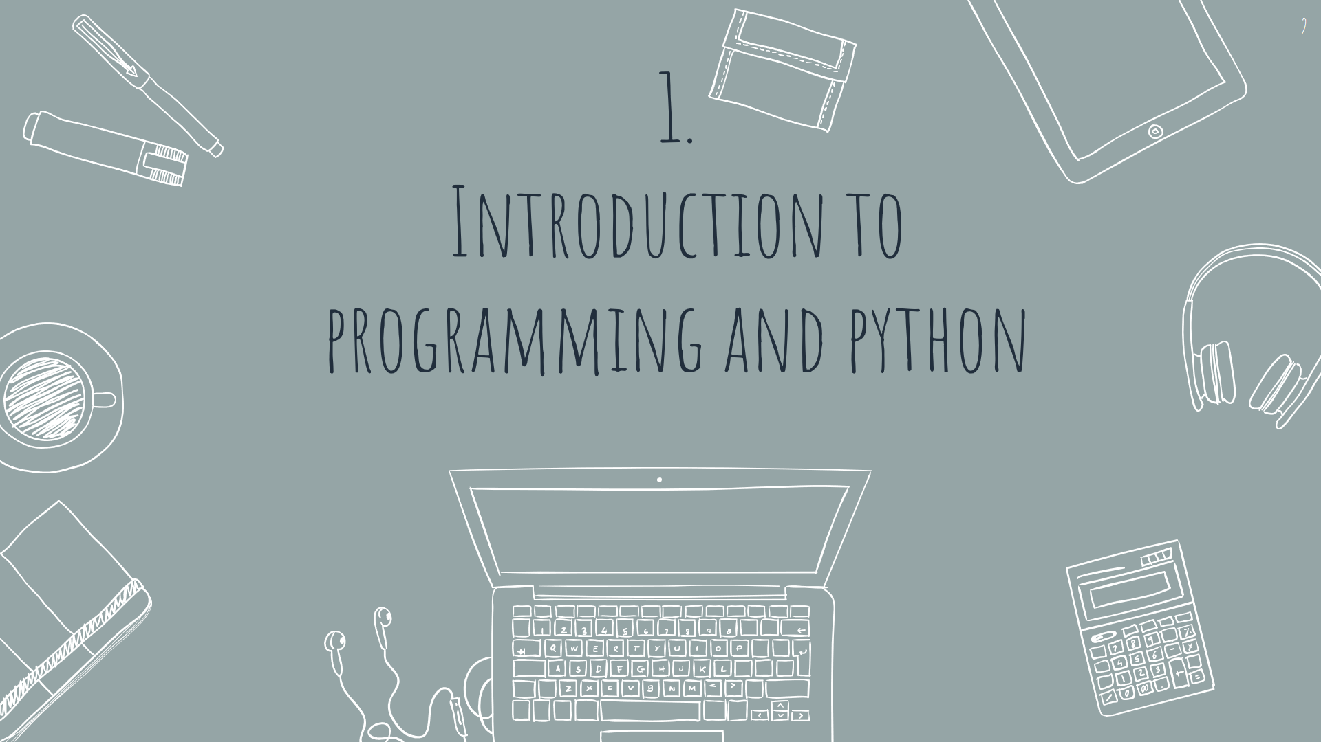

Slide 2
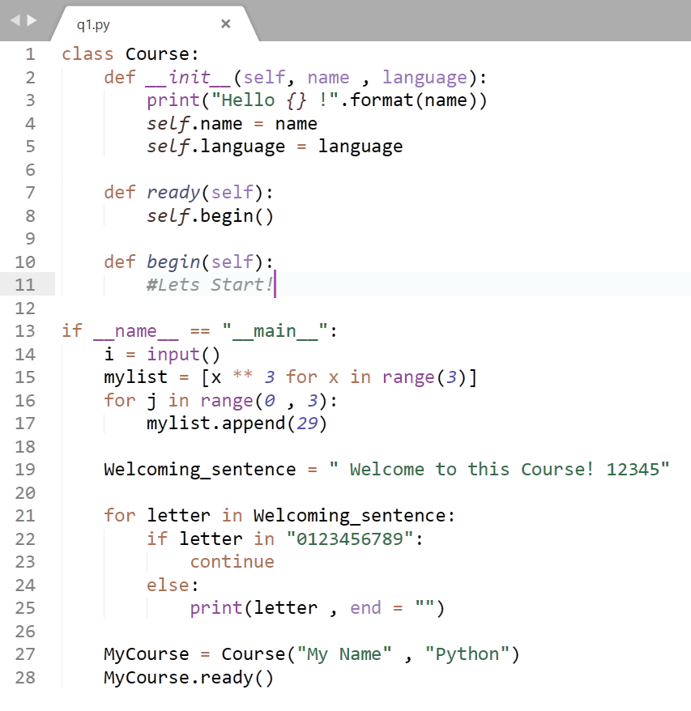
Welcome!
Welcome to the Python Hero Academy.
In this course, you'll learn programming with python from basics to advanced. Take a real college-like course without the limitations of one!

Slide 3
“Everybody should learn how to program a computer, because it teaches you how to think.”
—Steve Jobs

Slide 4
Contents
What is a programming language?
1
High level vs Low level languages
2
Interpreted vs Compiled languages
3
A very simple description of what programming languages are
What they are and a simple comparison between them
What they are and a simple comparison between them

Slide 5
What is a programming language?
A language (like any other languages)
Contains vocabulary and grammar rules
Many different divisions for programming languages such as
High level vs Low level languages
Compiled vs Interpreted
Imperative vs Declarative
Functional Programming Language, Object-oriented Programming Language, Logic Programming Language and etc.

Slide 6
Contents
What is a programming language?
1
High level vs Low level languages
2
Interpreted vs Compiled languages
3
A very simple description of what programming languages are
What they are and a simple comparison between them
What they are and a simple comparison between them

Slide 7
High level vs low level languages
High level languages
Low level languages
Closer to our understanding
Easier to work with
Slower because Must be translated to low level languages
Java, C++, Python and etc.
They’re divided to two groups
Interpreted languages
Compiled languages
mostly describes machine’s functionality
Assembly or any machine’s code.

Slide 8
Contents
What is a programming language?
1
High level vs Low level languages
2
Interpreted vs Compiled languages
3
A very simple description of what programming languages are
What they are and a simple comparison between them
What they are and a simple comparison between them

Slide 9
Interpreted vs Compiled languages
A bit vague… → A language can be translated by both methods
Each language → originally designed to be translated by one of them
Both high level
In a compiled language:
The target machine directly translates the program
In an interpreted language:
The source code is not directly translated
Another program, aka the interpreter, reads and executes the code
Ancient Greek translator example

Slide 10
Interpreted vs Compiled languages
An Interpreted language compared to a Compiled one is:
Slower (-)
Less efficient(-)
Gives less control over memory and processing unit(-)
Easier to use(+)
Easier to understand and design algorithms (+)
Python is a high-level Interpreted language.

Slide 11

Thanks!
Got any questions or suggestions?
Here’s some contact info:
@KMasoumi

